Slide 1
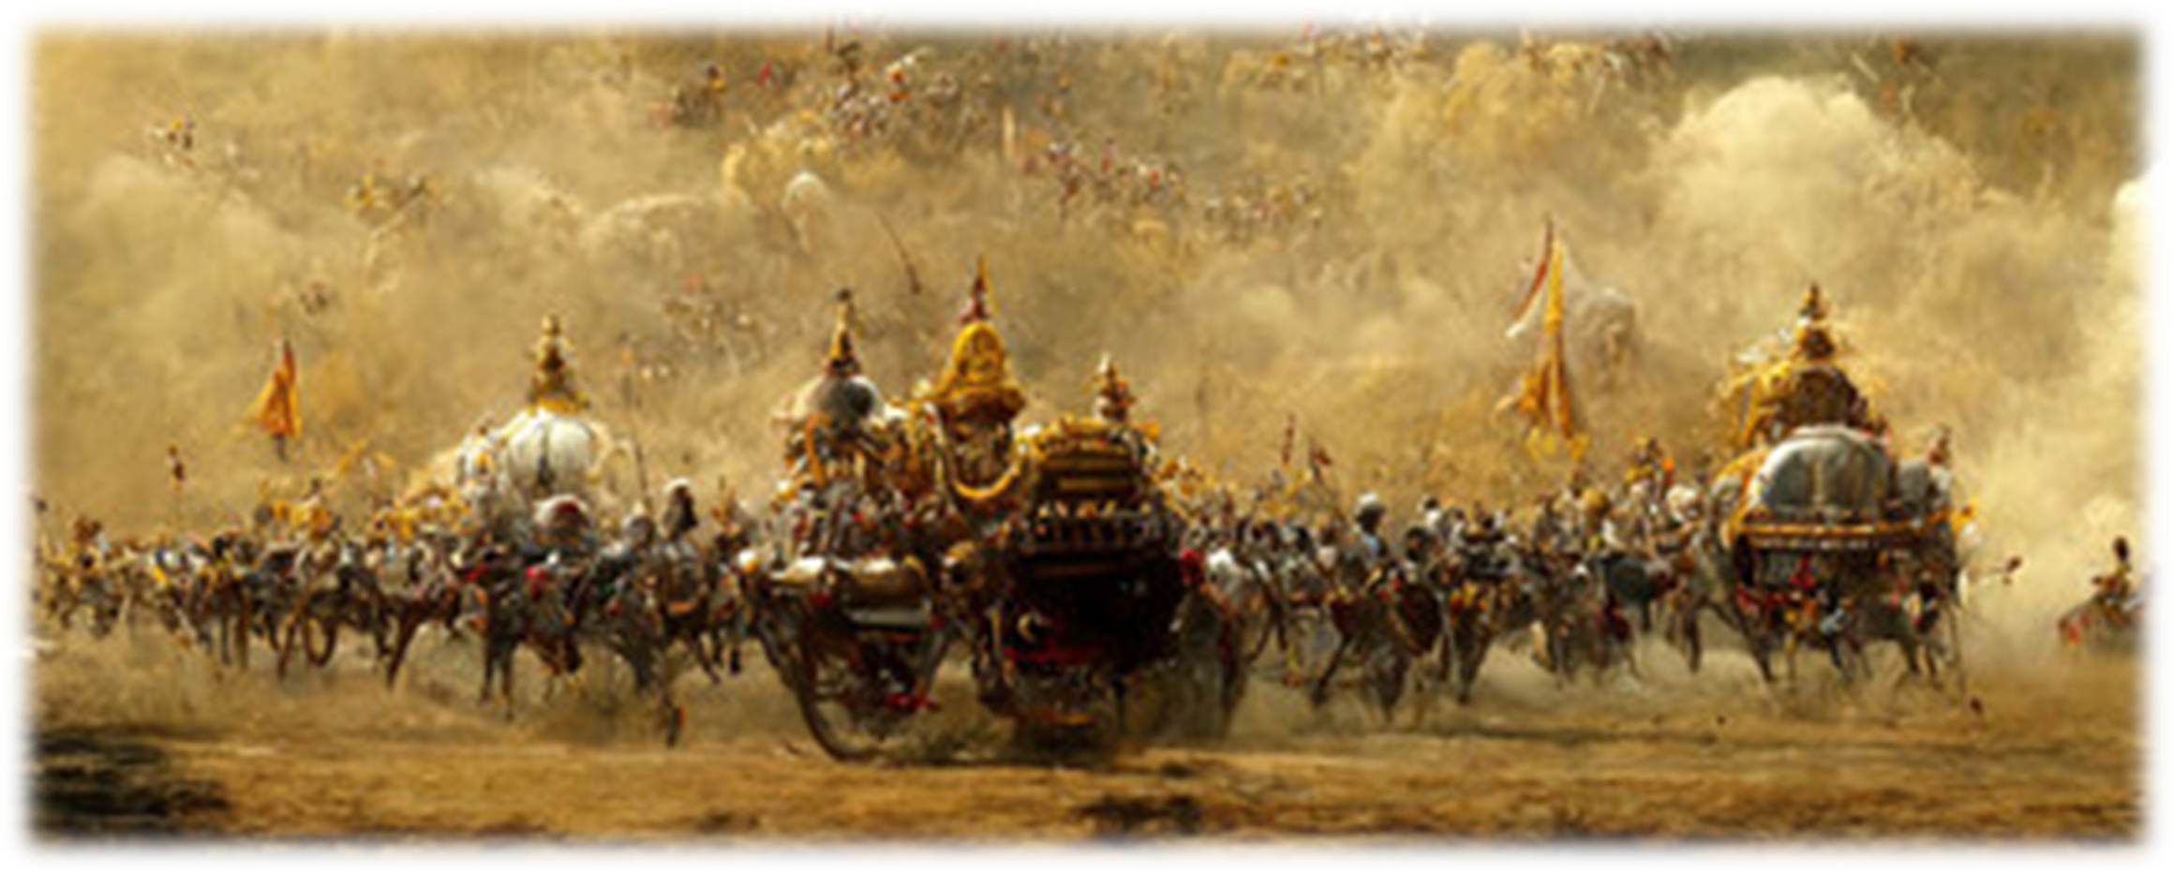
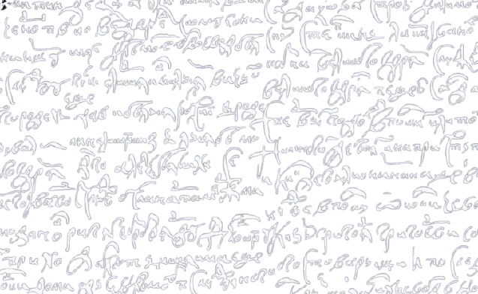
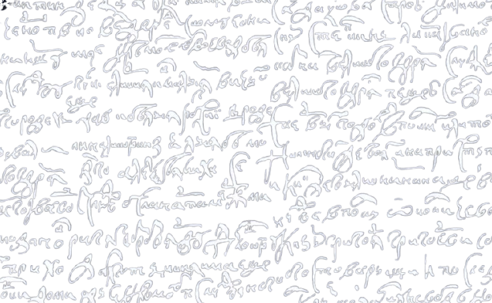
Delhi Public School, Ranipur
Welcomes You
to
The Inter School Literary Competition
English Literari Concurso 2025

Slide 2
Delhi Public School, Ranipur
Welcomes You
to
The Inter School Literary Competition
English Literari Concurso 2025

Slide 3
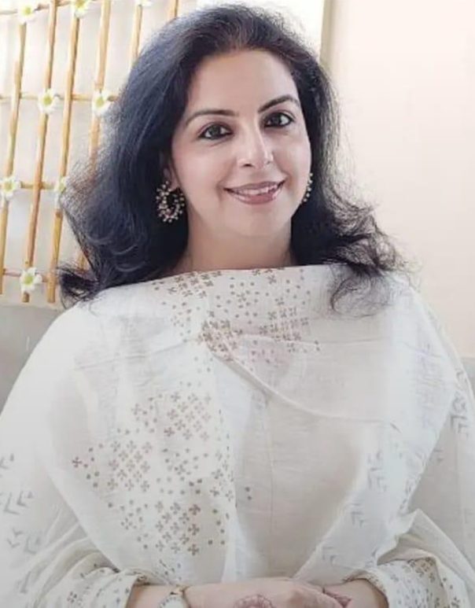
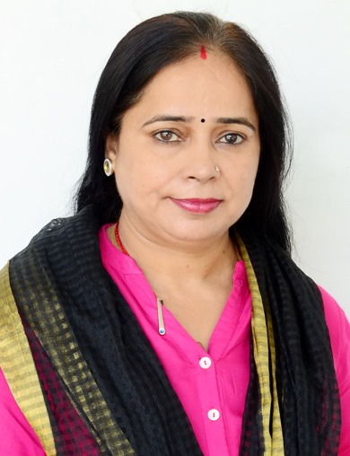
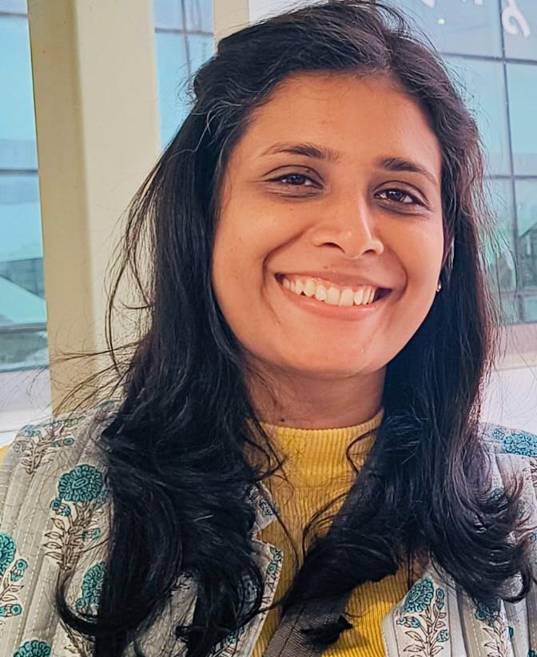
English Literari Concurso 2025
Ms. Shikha Kumar
Personality Development Trainer
Dr Bharti Sharma
Associate Professor in the Department of English at S.D. College, Roorkee
Dr. Aashima Sharma
Head of the Modern Subjects Department at Shri Bhagwan Das Sanskrit Mahavidyalaya
Today’s
Panel of Judges

Slide 4
English Literari Concurso 2025
Ms. Shikha Kumar
Personality Development Trainer
Dr. Aashima Sharma
Head of the Modern Subjects Department at Shri Bhagwan Das Sanskrit Mahavidyalaya
Dr Bharti Sharma
Associate Professor in the Department of English at S.D. College, Roorkee

Slide 5
English Literari Concurso 2025
Dr Bharti Sharma
Associate Professor in the Department of English at S.D. College, Roorkee
Ms. Shikha Kumar
Personality Development Trainer
Dr. Aashima Sharma
Head of the Modern Subjects Department at Shri Bhagwan Das Sanskrit Mahavidyalaya

Slide 6
English Literari Concurso 2025
Ms. Shikha Kumar
Personality Development Trainer
Dr Bharti Sharma
Associate Professor in the Department of English at S.D. College, Roorkee
Dr. Aashima Sharma
Head of the Modern Subjects Department at Shri Bhagwan Das Sanskrit Mahavidyalaya

Slide 7
Welcome
Dr. Aashima Sharma
Dr Bharti Sharma
Ms. Shikha Kumar

Slide 8
English Literari
Concurso 2025

Slide 9

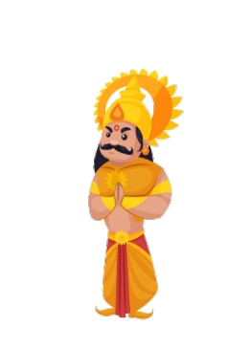
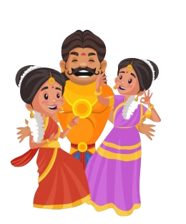
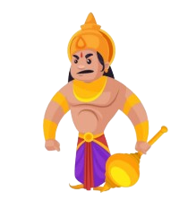
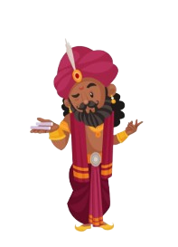
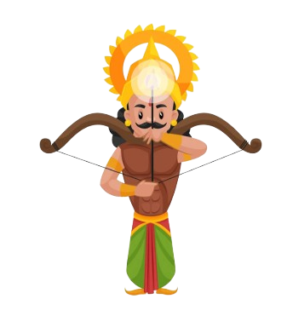
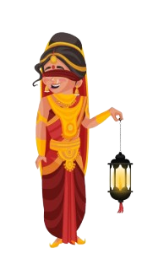
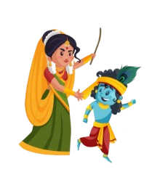
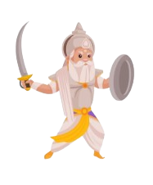
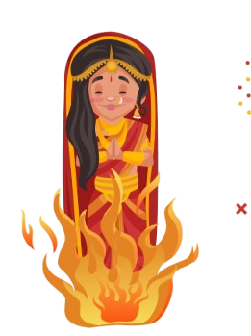
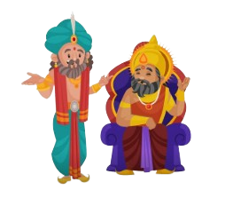
Thank you to all the participants,
making mythology breathe, speak, and shine on this stage,
with the creative and unforgettable performances !

Slide 10
Waiting for results ...
English Literari
Concurso 2025

Slide 11
English Literari
Concurso 2025
Results Declared !
Waiting for results ...

